Slide 1
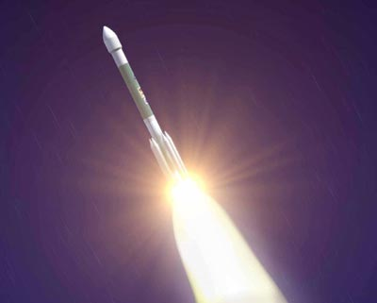
Stowed in the nose cone of this Delta II rocket, the Mars Exploration Rover blasts off from the Kennedy Space Center in Florida. It's destination: the planet Mars.
Return to Menu Next Slide

Slide 2
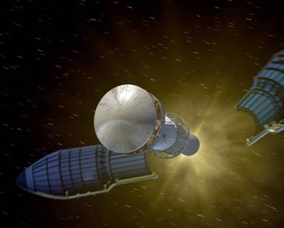
The nose cone of the rocket separates during the launch phase and the Mars Exploration Rover is sent on a seven-month journey to Mars.
Return to Menu Previous Slide Next Slide

Slide 3
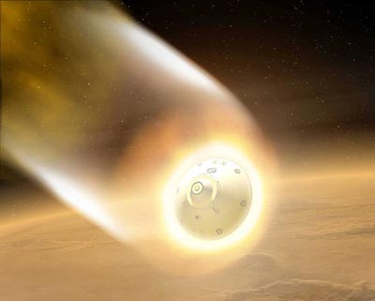
The aeroshell protects the rover from fiery temperatures as it enters the Martian atmosphere.
Return to Menu Previous Slide Next Slide

Slide 4
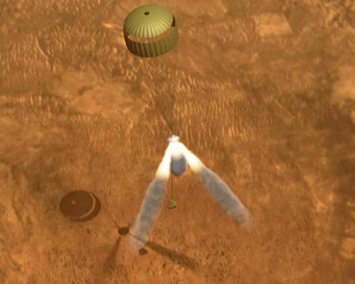
With the parachute deployed, three retrorockets fired their engines, suspending the lander 30 - 50 feet above the Martian surface.
Return to Menu Previous Slide Next Slide

Slide 5
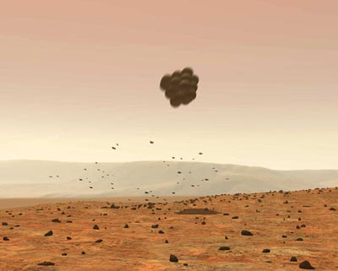
Protected by large airbags, the lander fell away from the parachute, landing safely on Mars.
Return to Menu Previous Slide Next Slide

Slide 6
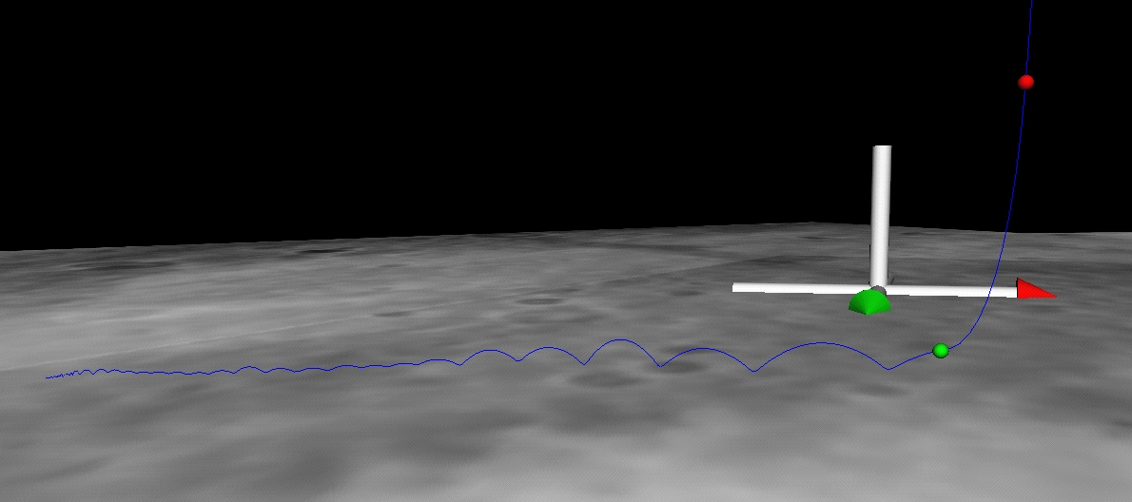
This image shows the path (blue line) taken by the Mars Exploration Rover Spirit as it bounced down to its final resting spot in Gusev Crater, Mars. Data taken by Spirit during descent indicates that the rover bounced 28 times, including one dip into a crater. The green dot shows where the parachute bridle was cut, and the red dot indicates where the main retrorockets were fired.
Return to Menu Previous Slide Next Slide

Slide 7
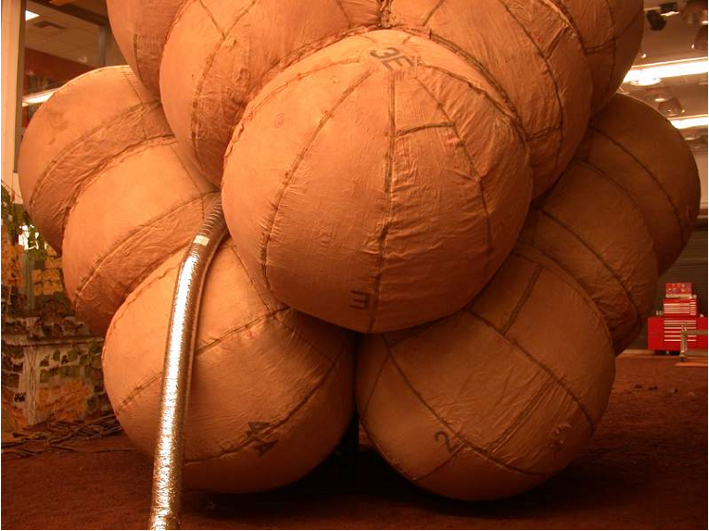
The airbags are fully inflated in this photograph taken at the JPL In-Situ Instrument Laboratory or "Testbed." The airbags had to be inflated seconds before landing on Mars' surface and deflated once safely on the ground.
Return to Menu Previous Slide

